Slide 1
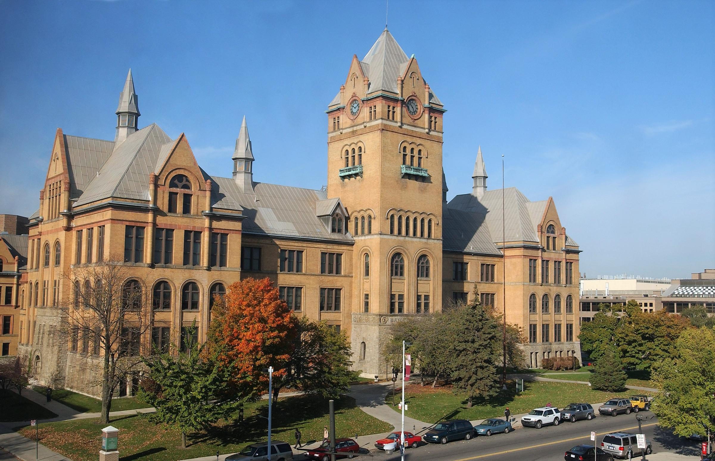
Demand Characterization and Codesign of Dynamics-Adaptive Real-Time Systems
Prospectus Defense - Aaron Willcock (aaron.willcock@wayne.edu)
Advisor – Professor Nathan Fisher (fishern@wayne.edu)

Slide 2
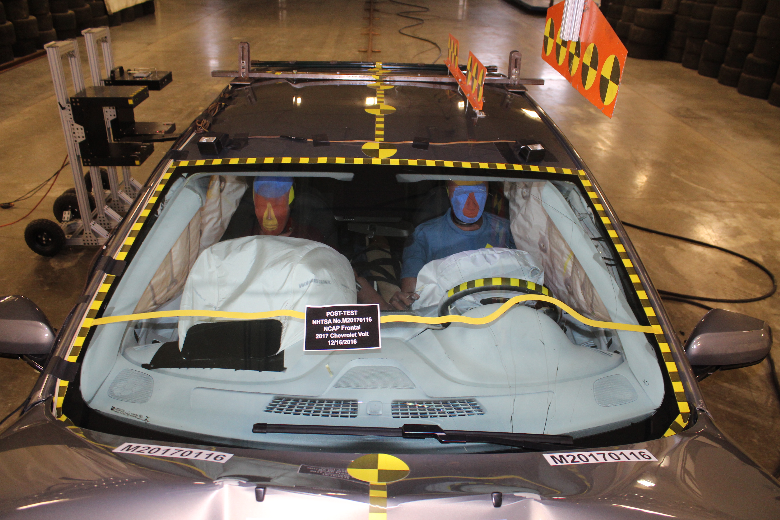
Hard Real-Time Systems
Systems which:
require logically and temporally correct results;
incur catastrophic failure when either logical or temporal errors occur;
Image Provided by: National Highwat Traffic Safety Administration.

Slide 3
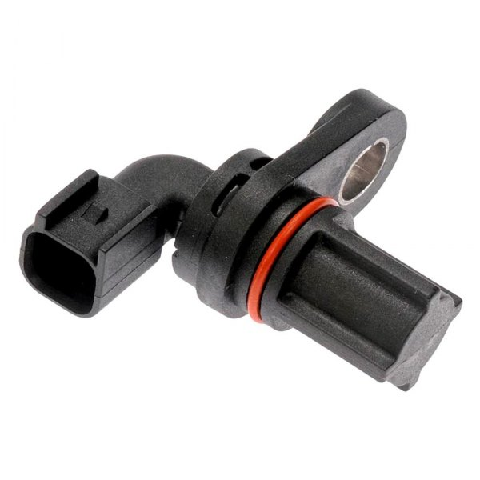
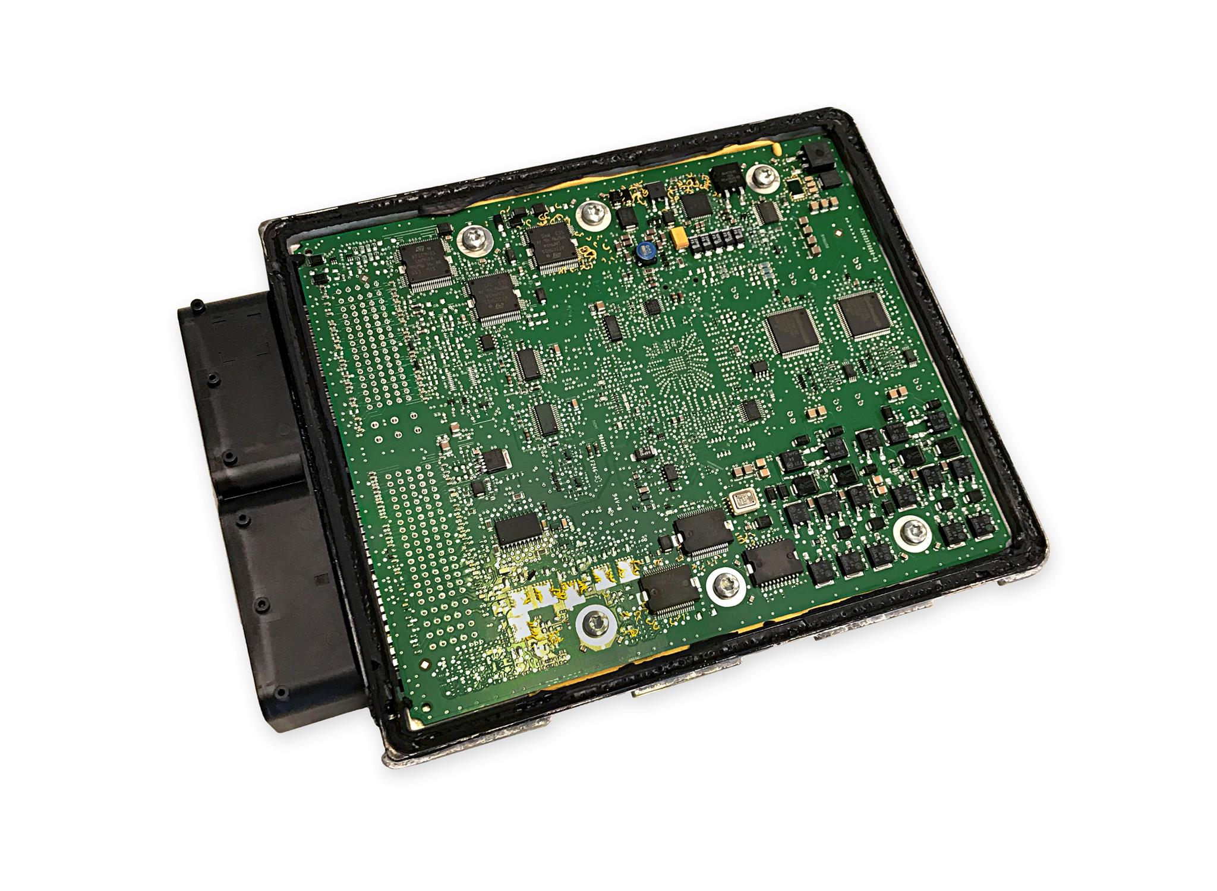
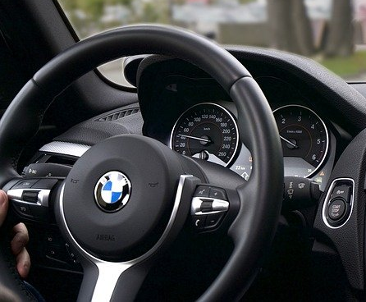
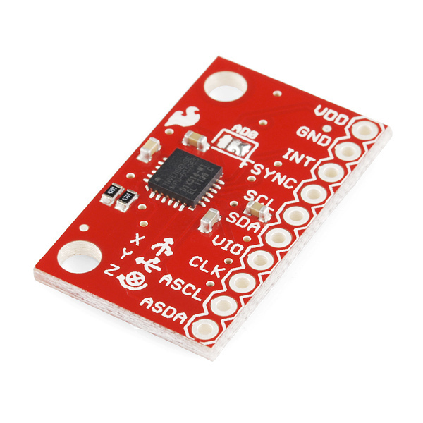
Hard Real-Time Systems: Airbags
Simplified Airbag System
Wheel Speed Sensor
Logical Failure:
Incorrectly fire airbag (when there is no collision)
Fail to fire during collision
Temporal Failure:
Fire airbag too early (bag is deflating on impact)
Fire airbag too late (bag strikes occupant)
Image Provided by: Dorman.
ECU
Airbag
IMU
Image Provided by: HydraMotorWorks.
Image Provided by: Pixabay.
Image Provided by: SparkFun.

Slide 4
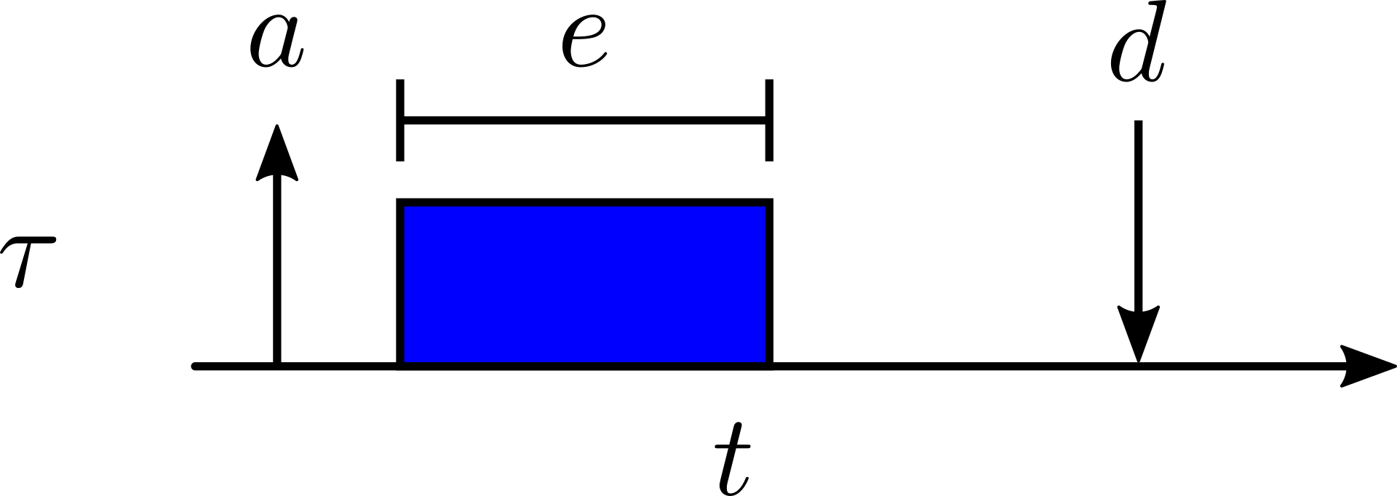
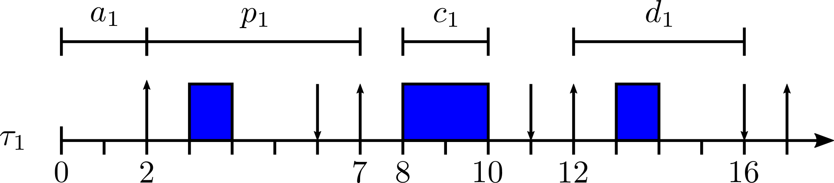
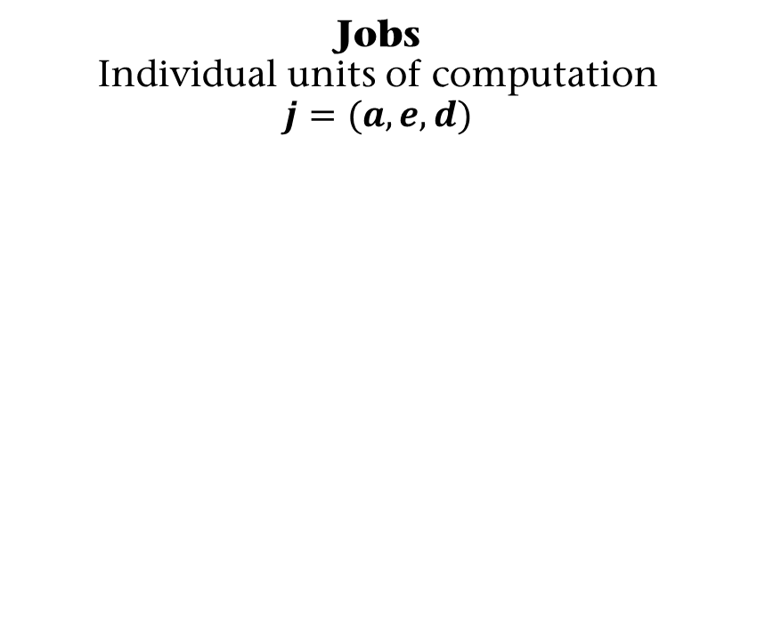

Real-Time Systems: Jobs & Tasks
Jobs Individual units of computation
$$j=(a,e,d)$$
Tasks Infinite sequence of jobs
$$τ=(a,p,c,d)$$
$$τ_{1}=(2,5,2,4)$$

Slide 5

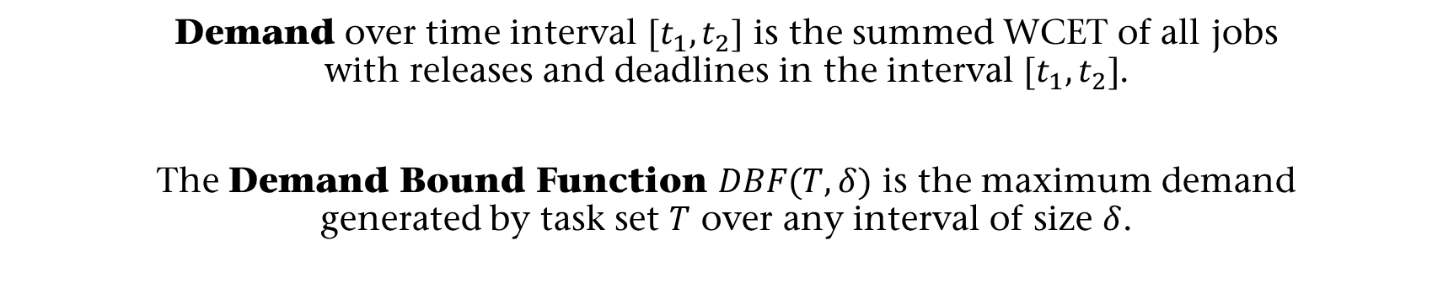
Real-Time Systems: Demand
Demand over time interval $[t_{1},t_{2}]$ is the summed WCET of all jobs with releases and deadlines in the interval $[t_{1},t_{2}]$.
The Demand Bound Function $DBF(T,δ)$ is the maximum demand generated by task set $T$ over any interval of size $δ$.

Slide 6
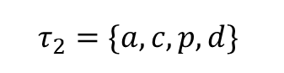
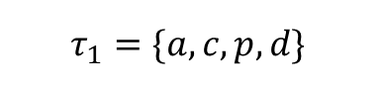
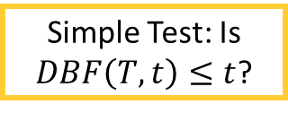

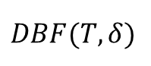
Problem & Motivation
Traditional real-time tasks have static task parameters (ex. $a, c, p,d$)
Static Tasks
Demand Char. / Sched. Analysis
Result
$$τ_{1}=\{a, c, p,d\}$$
PASS
$$DBF(T,δ)$$
$$τ_{2}=\{a, c,p, d\}$$
FAIL
Simple Test: Is $DBF\left(T,t\right)≤t$?

Slide 7
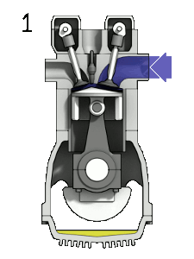
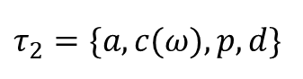
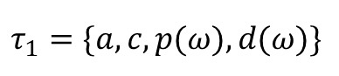
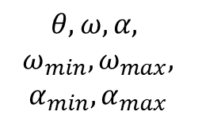
Problem & Motivation
Recent research thrusts in Cyber Physical Systems tightly integrate software and hardware.
In Real-Time Systems, this integration has manifested as tasks with adaptive parameters.
Extracted Dynamics
Dynamics- Adaptive Tasks
Physical System
Static Tasks
Demand Char. / Sched. Analysis
Result
$$τ_{1}=\{a, c, p(ω), d(ω)\}$$
PASS
$$θ,ω,α,$$
$$ω_{min},ω_{max},$$
$$α_{min},α_{max}$$
$$τ_{1}=\{a, c, p,d\}$$
$$DBF(T,δ)$$
$$τ_{2}=\{a, c(ω), p, d\}$$
FAIL
$$τ_{2}=\{a, c,p, d\}$$

Slide 8
Problem & Motivation
Tasks with adaptive parameters complicate demand characterization and schedulability analysis by making analysis unintuitive and intractable.
Physical System
Extracted Dynamics
Dynamics- Adaptive Tasks
Demand Char. / Sched. Analysis
Result
$$θ,ω,α,$$
$$ω_{min},ω_{max},$$
$$α_{min},α_{max}$$
$$τ_{1}=\{a, c, p(ω), d(ω)\}$$
PASS
$$DBF(T,δ)$$
$$τ_{2}=\{a, c(ω), p, d\}$$
FAIL

Slide 9
Problem & Motivation
Approach
Tasks with adaptive parameters complicate demand characterization and schedulability analysis by making analysis unintuitive and intractable.
Physical System
Extracted Dynamics
Dynamics- Adaptive Tasks
Demand Char. / Sched. Analysis
Result
$$θ,ω,α,$$
$$ω_{min},ω_{max},$$
$$α_{min},α_{max}$$
$$τ_{1}=\{a, c, p(ω), d(ω)\}$$
PASS
$$DBF(T,δ)$$
$$τ_{2}=\{a, c(ω), p, d\}$$
FAIL

Slide 10
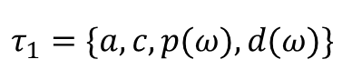
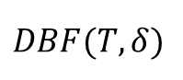
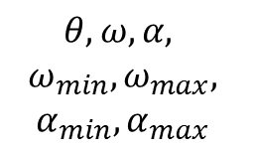
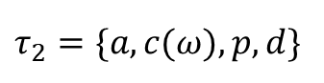
Approach
Physical System
Extracted Dynamics
Dynamics- Adaptive Tasks
Demand Char. / Sched. Analysis
Result
$$θ,ω,α,$$
$$ω_{min},ω_{max},$$
$$α_{min},α_{max}$$
$$τ_{1}=\{a, c, p(ω), d(ω)\}$$
PASS
$$DBF(T,δ)$$
$$τ_{2}=\{a, c(ω), p, d\}$$
FAIL

Slide 11
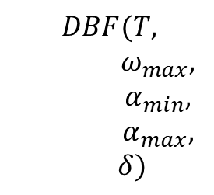
Approach
Physical System
Extracted Dynamics
Dynamics- Adaptive Tasks
Demand Char. / Sched. Analysis
Result
$$DBF(T,$$ $ω_{max},$ $α_{min},$ $${ α}_{max},$$ $δ)$
$$θ,ω,α,$$
$$ω_{min},ω_{max},$$
$$α_{min},α_{max}$$
$$τ_{1}=\{a, c, p(ω), d(ω)\}$$
PASS
$$DBF(T,δ)$$
$$τ_{2}=\{a, c(ω), p, d\}$$
FAIL
1. Leverage limitations of physical system dynamics to reduce pessimism and increase efficiency of demand characterization

Slide 12
Approach
Physical System
Extracted Dynamics
Dynamics- Adaptive Tasks
Demand Char. / Sched. Analysis
Result
$$DBF(T,$$ $ω_{max},$ $α_{min},$ $${ α}_{max},$$ $δ)$
$$θ,ω,α,$$
$$ω_{min},ω_{max},$$
$$α_{min},α_{max}$$
$$τ_{1}=\{a, c, p(ω), d(ω)\}$$
PASS
$$τ_{2}=\{a, c(ω), p, d\}$$
FAIL
1. Leverage limitations of physical system dynamics to reduce pessimism and increase efficiency of demand characterization
2. Establish bidirectional relationships between system dynamics and schedulability to facilitate codesign.

Slide 13
Thesis
Incorporating physical dynamics into real-time system analysis can reduce pessimism and increase efficiency of demand characterization and schedulability analysis while enabling the codesign of Real-Time Cyber-Physical Systems
Physical System
Extracted Dynamics
Dynamics- Adaptive Tasks
Demand Char. / Sched. Analysis
Result
$$DBF(T,$$ $ω_{max},$ $α_{min},$ $${ α}_{max},$$ $δ)$
$$θ,ω,α,$$
$$ω_{min},ω_{max},$$
$$α_{min},α_{max}$$
$$τ_{1}=\{a, c, p(ω), d(ω)\}$$
PASS
$$τ_{2}=\{a, c(ω), p, d\}$$
FAIL

Slide 14
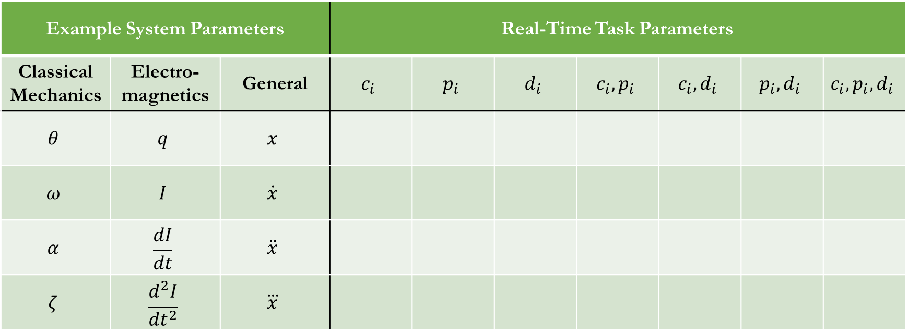
Related Work: Simple Derivatives
Example System Parameters |  |  | Real-Time Task Parameters
Classical Mechanics | Electro- magnetics | General | $$c_{i}$$ | $$p_{i}$$ | $$d_{i}$$ | $$c_{i},p_{i}$$ | $$c_{i}, d_{i}$$ | $$p_{i},d_{i}$$ | $$c_{i},p_{i},d_{i}$$
$$θ$$ | $$q$$ | $$x$$
$$ω$$ | $$I$$ | $$\dot{x}$$
$$α$$ | $$\frac{dI}{dt}$$ | $$\ddot{x}$$
$$ζ$$ | $$\frac{d^{2}I}{{dt}^{2}}$$ | $$\overset{⃛}{x}$$
Notes:
Take note of dimensions covered, Derivatives used, Intersection points

Slide 15
Related Work: Simple Derivatives
Example System Parameters |  |  | Real-Time Task Parameters
Classical Mechanics | Electro- magnetics | General | $$c_{i}$$ | $$p_{i}$$ | $$d_{i}$$ | $$c_{i},p_{i}$$ | $$c_{i}, d_{i}$$ | $$p_{i},d_{i}$$ | $$c_{i},p_{i},d_{i}$$
$$θ$$ | $$q$$ | $$x$$
$$ω$$ | $$I$$ | $$\dot{x}$$
$$α$$ | $$\frac{dI}{dt}$$ | $$\ddot{x}$$
$$ζ$$ | $$\frac{d^{2}I}{{dt}^{2}}$$ | $$\overset{⃛}{x}$$
Notes:
Take note of dimensions covered, Derivatives used, Intersection points

Slide 16
Related Work: Simple Derivatives
Example System Parameters |  |  | Real-Time Task Parameters
Classical Mechanics | Electro- magnetics | General | $$c_{i}$$ | $$p_{i}$$ | $$d_{i}$$ | $$c_{i},p_{i}$$ | $$c_{i}, d_{i}$$ | $$p_{i},d_{i}$$ | $$c_{i},p_{i},d_{i}$$
$$θ$$ | $$q$$ | $$x$$
$$ω$$ | $$I$$ | $$\dot{x}$$
$$α$$ | $$\frac{dI}{dt}$$ | $$\ddot{x}$$
$$ζ$$ | $$\frac{d^{2}I}{{dt}^{2}}$$ | $$\overset{⃛}{x}$$
Notes:
Take note of dimensions covered, Derivatives used, Intersection points

Slide 17
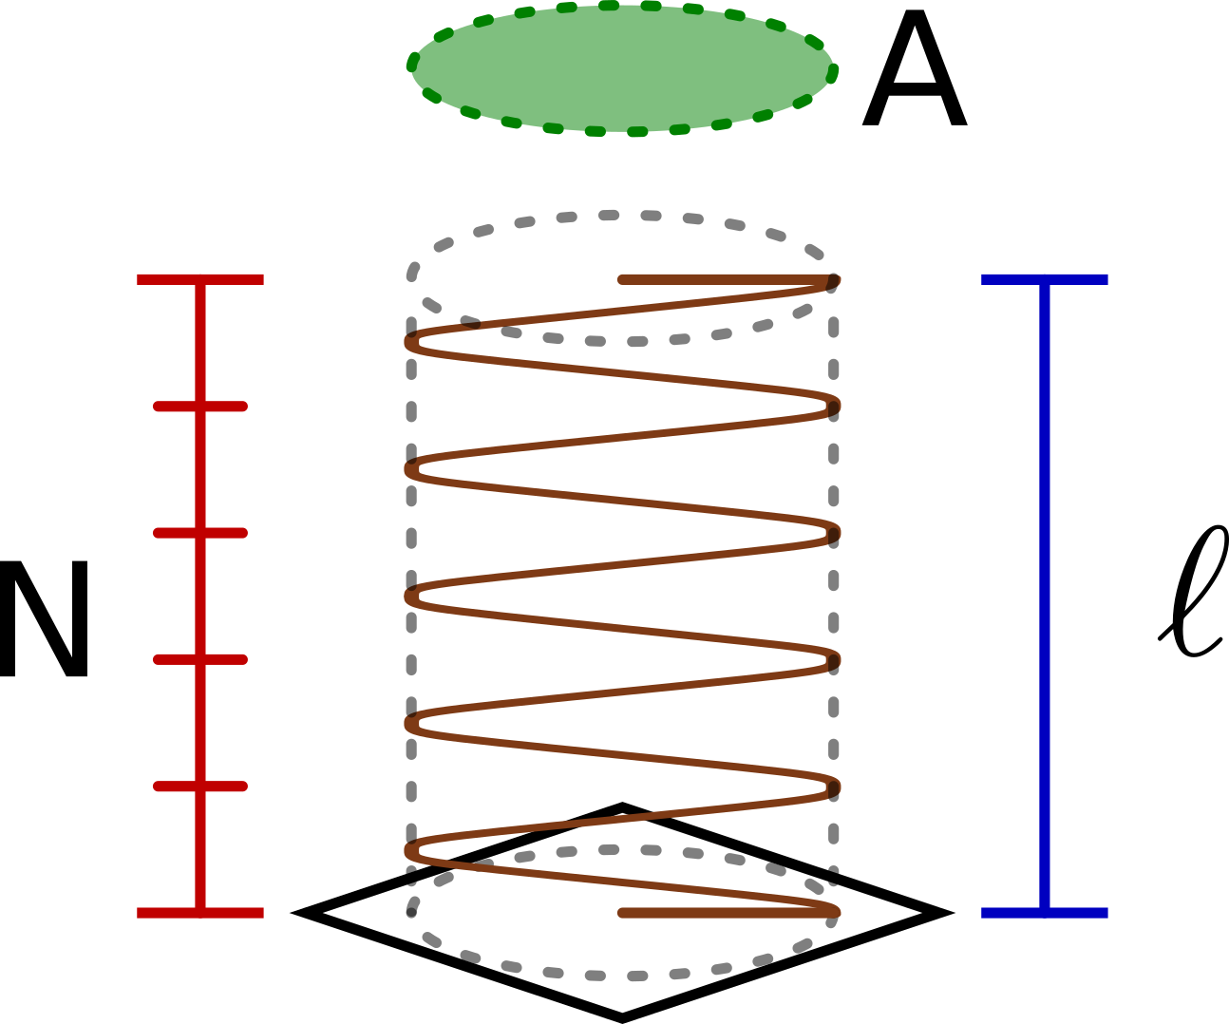
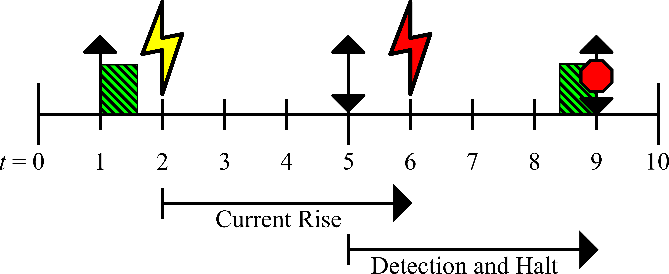
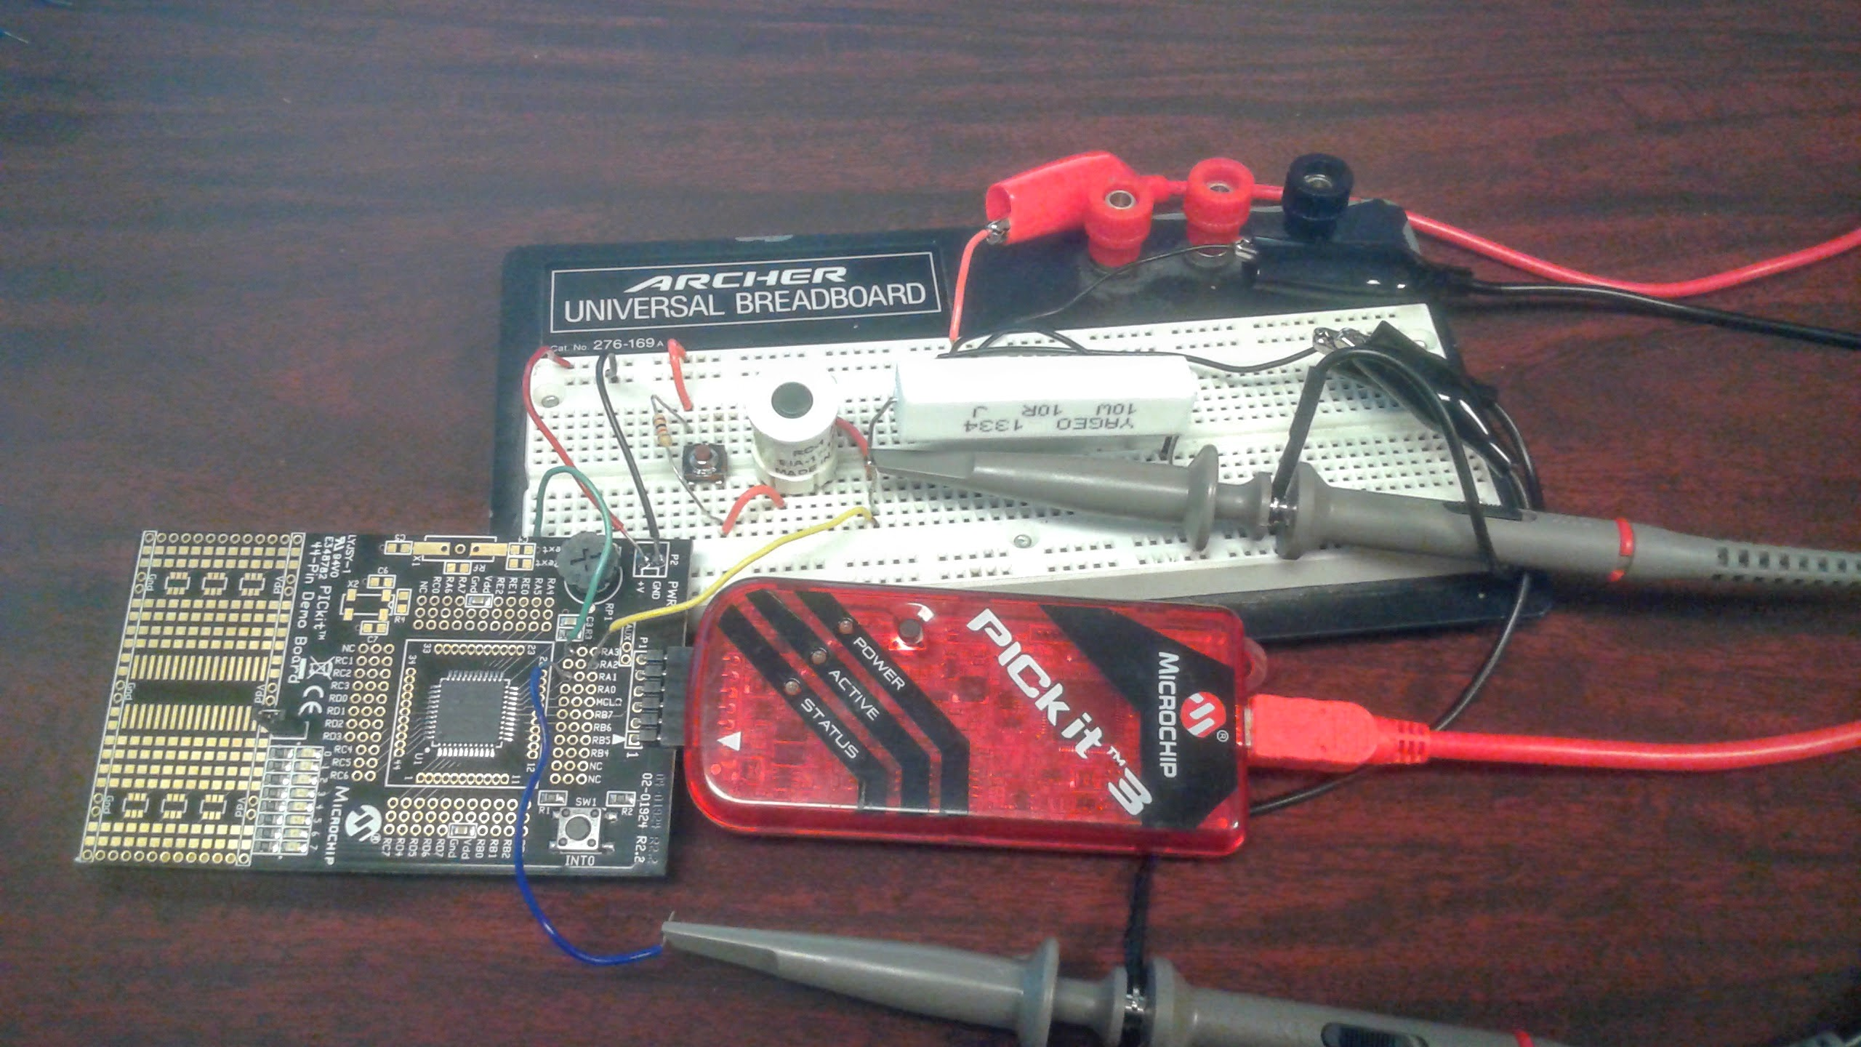
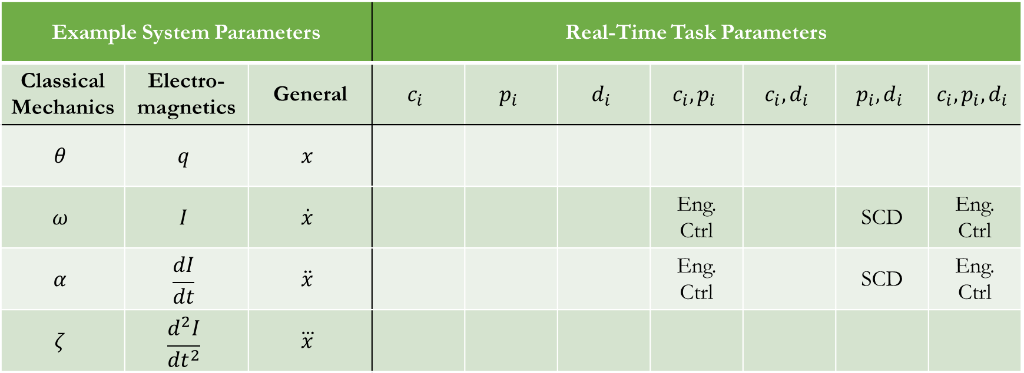
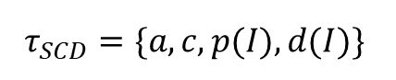
Related Work: Electromagnetics
Example System Parameters |  |  | Real-Time Task Parameters
Classical Mechanics | Electro- magnetics | General | $$c_{i}$$ | $$p_{i}$$ | $$d_{i}$$ | $$c_{i},p_{i}$$ | $$c_{i}, d_{i}$$ | $$p_{i},d_{i}$$ | $$c_{i},p_{i},d_{i}$$
$$θ$$ | $$q$$ | $$x$$
$$ω$$ | $$I$$ | $$\dot{x}$$ |  |  |  | Eng. Ctrl |  | SCD | Eng. Ctrl
$$α$$ | $$\frac{dI}{dt}$$ | $$\ddot{x}$$ |  |  |  | Eng. Ctrl |  | SCD | Eng. Ctrl
$$ζ$$ | $$\frac{d^{2}I}{{dt}^{2}}$$ | $$\overset{⃛}{x}$$
Short Circuit Detection: A Quick Summary
Inductor Model
Mapped to RT Task
Protect Against Short Circuits
$$τ_{SCD}=\{a, c, p(I), d(I)\}$$
Notes:
Take note of dimensions covered, Derivatives used, Intersection points

Slide 18
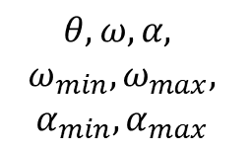
Related Work: Classical Mechanics
Example System Parameters |  |  | Real-Time Task Parameters
Classical Mechanics | Electro- magnetics | General | $$c_{i}$$ | $$p_{i}$$ | $$d_{i}$$ | $$c_{i},p_{i}$$ | $$c_{i}, d_{i}$$ | $$p_{i},d_{i}$$ | $$c_{i},p_{i},d_{i}$$
$$θ$$ | $$q$$ | $$x$$
$$ω$$ | $$I$$ | $$\dot{x}$$ |  |  |  | Eng. Ctrl |  | SCD | Eng. Ctrl
$$α$$ | $$\frac{dI}{dt}$$ | $$\ddot{x}$$ |  |  |  | Eng. Ctrl |  | SCD | Eng. Ctrl
$$ζ$$ | $$\frac{d^{2}I}{{dt}^{2}}$$ | $$\overset{⃛}{x}$$
Engine Control Tasks
Physical System
Extracted Dynamics
Engine Control Tasks
$$θ,ω,α,$$
$$ω_{min},ω_{max},$$
$$α_{min},α_{max}$$
$$τ_{1}=\{a, c, p(ω), d(ω)\}$$
$$τ_{2}=\{a, c(ω), p, d\}$$
Notes:
Take note of dimensions covered, Derivatives used, Intersection points

Slide 19
Related Work: What We’ll Cover
Example System Parameters |  |  | Real-Time Task Parameters
Classical Mechanics | Electro- magnetics | General | $$c_{i}$$ | $$p_{i}$$ | $$d_{i}$$ | $$c_{i},p_{i}$$ | $$c_{i}, d_{i}$$ | $$p_{i},d_{i}$$ | $$c_{i},p_{i},d_{i}$$
$$θ$$ | $$q$$ | $$x$$
$$ω$$ | $$I$$ | $$\dot{x}$$ |  |  |  | Eng. Ctrl |  | SCD | Eng. Ctrl
$$α$$ | $$\frac{dI}{dt}$$ | $$\ddot{x}$$ |  |  |  | Eng. Ctrl |  | SCD | Eng. Ctrl
$$ζ$$ | $$\frac{d^{2}I}{{dt}^{2}}$$ | $$\overset{⃛}{x}$$
SCD
covered in MS.
Eng Ctrl.
will be the focus for remainder of presentation.
Notes:
Take note of dimensions covered, Derivatives used, Intersection points

Slide 20

An Efficient Knapsack-Based Approach for Calculating the Worst-Case Demand of AVR Tasks
Sandeep Kumar Bijinemula*, Aaron Willcock†,
Thidapat Chantem*, Nathan Fisher†
*Department of Electrical and Computer Engineering, Virginia Tech, USA
†Department of Computer Science, Wayne State University, USA
Notes:
collaboration

Slide 21
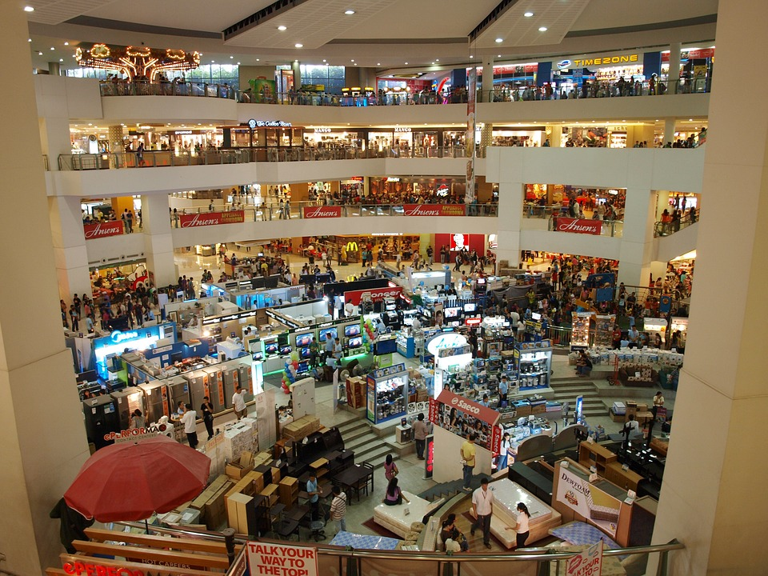
Stealing from Stores
Imagine your favorite store.
You have 100 seconds to take anything …for free
Where would you start?
What would you take?
Notes:
Media Markt. For those who recognize, this is akin to the typical knapsack problem.

Slide 22







Stealing from Stores
Goal:
Maximize value over 100 seconds
Increase value
Decrease time
$$<$$
$$<$$

Slide 23

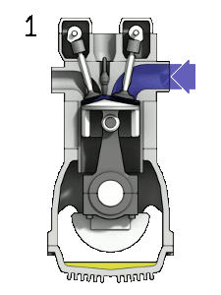
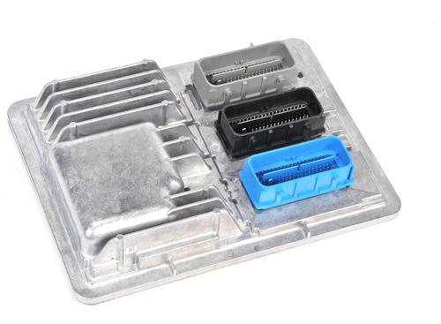



Stealing from Stores
Engine Control Module (ECM)
Value of Items
Image Provided by: Zephyris.
https://commons.wikimedia.org/wiki/
File:4StrokeEngine_Ortho_3D_Small.gif
Items per Second

Slide 24
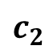
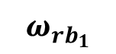
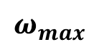
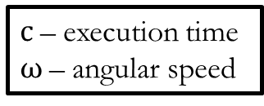
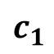
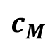
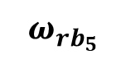
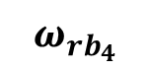
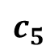
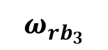
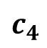
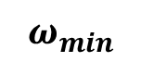
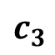
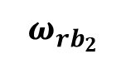
Engine Control: Adaptive Variable-Rate (AVR) Tasks
Stealing from Stores
Engine Control Module (ECM)
$$c_{1}$$
Execution Times of the Modes
Value of Items
$$c_{2}$$
$$c_{3}$$
$$c_{4}$$
Image Provided by: Zephyris.
https://commons.wikimedia.org/wiki/
File:4StrokeEngine_Ortho_3D_Small.gif
$$c_{5}$$
$$c_{M}$$
$$ω_{min}$$
$$ω_{{rb}_{1}}$$
$$ω_{{rb}_{2}}$$
$$ω_{{rb}_{3}}$$
$$ω_{{rb}_{4}}$$
$$ω_{{rb}_{5}}$$
$$ω_{max}$$
c – execution time
$ω$ – angular speed
Items per Second
Speeds
Biondi et al. [ICCPS ‘15]

Slide 25
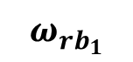
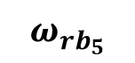
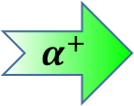







Engine Control: Adaptive Variable-Rate (AVR) Tasks
Jobs released at Top Dead Center (TDC)
Jobs due in one revolution (one full rotation)
$$c_{1}$$
Execution Times of the Modes
$$c_{2}$$
$$α^{+}$$
$$c_{3}$$
Higher rate of job release
$$c_{4}$$
Lower WCET per job
$$c_{5}$$
Higher rate of job release
Less time between job releases
$$c_{M}$$
$$ω_{min}$$
$$ω_{{rb}_{1}}$$
$$ω_{{rb}_{2}}$$
$$ω_{{rb}_{3}}$$
$$ω_{{rb}_{4}}$$
$$ω_{{rb}_{5}}$$
$$ω_{max}$$
c – execution time
$ω$ – angular speed
$$α^{+}$$
Speeds
Biondi et al. [ICCPS ‘15]

Slide 26


Engine Control: Adaptive Variable-Rate (AVR) Tasks
Jobs released at Top Dead Center (TDC)
Jobs due in one revolution (one full rotation)
$$c_{1}$$
Execution Times of the Modes
$$c_{2}$$
$$α^{−}$$
$$c_{3}$$
But how do we calculate worst-case demand?
Higher rate of job release
$$c_{4}$$
Higher WCET per job
$$c_{5}$$
Higher rate of job release
More time between job releases
$$c_{M}$$
$$ω_{min}$$
$$ω_{{rb}_{1}}$$
$$ω_{{rb}_{2}}$$
$$ω_{{rb}_{3}}$$
$$ω_{{rb}_{4}}$$
$$ω_{{rb}_{5}}$$
$$ω_{max}$$
c – execution time
$ω$ – angular speed
$$α^{−}$$
Speeds
Biondi et al. [ICCPS ‘15]
Notes:
These are real-time tasks which model the behavior of engine control tasks.
As engine speed increases, time between jobs decreases and WCET decreases.

Slide 27
Demand of AVR Tasks
Engine Control: Adaptive Variable-Rate (AVR) Tasks
Which point gives the worst-case demand?
$$c_{1}$$
Execution Times of the Modes
$$c_{2}$$
$$c_{3}$$
$$c_{4}$$
Calculation of worst-case demand is not straightforward.
$$c_{5}$$
$$c_{M}$$
$$ω_{min}$$
$$ω_{{rb}_{1}}$$
$$ω_{{rb}_{2}}$$
$$ω_{{rb}_{3}}$$
$$ω_{{rb}_{4}}$$
$$ω_{{rb}_{5}}$$
$$ω_{max}$$
c – execution time
$ω$ – angular speed
Speeds
Biondi et al. [ICCPS ‘15]
Notes:
These are real-time tasks which model the behavior of engine control tasks.
As engine speed increases, time between jobs decreases and WCET decreases.
We call the stretches of equal value "modes" or "steps" and the rightmost edge of the "step" a "right boundary".

Slide 28
Demand of AVR Tasks
$$c_{1}$$
Execution Times of the Modes
$$c_{2}$$
$$c_{3}$$
$$c_{4}$$
Calculation of worst-case demand is not straightforward.
$$c_{5}$$
$$c_{M}$$
$$ω_{min}$$
$$ω_{{rb}_{1}}$$
$$ω_{{rb}_{2}}$$
$$ω_{{rb}_{3}}$$
$$ω_{{rb}_{4}}$$
$$ω_{{rb}_{5}}$$
$$ω_{max}$$
c – execution time
$ω$ – angular speed
Speeds
Notes:
These are real-time tasks which model the behavior of engine control tasks.
As engine speed increases, time between jobs decreases and WCET decreases.

Slide 29

Motivation and Problem Statement
Demand of AVR Tasks
$$c_{1}$$
Motivation:
?
Execution Times of the Modes
Existing calculations of exact worst-case demand for AVR tasks are compute intensive.
$$c_{2}$$
$$c_{3}$$
$$c_{4}$$
Problem Statement:
$$c_{5}$$
Calculate the exact worst-case demand of an AVR task over a time interval $δ$.
Reduce algorithm runtime
$$c_{M}$$
$$ω_{min}$$
$$ω_{{rb}_{1}}$$
$$ω_{{rb}_{2}}$$
$$ω_{{rb}_{3}}$$
$$ω_{{rb}_{4}}$$
$$ω_{{rb}_{5}}$$
$$ω_{max}$$
c – execution time
$ω$ – angular speed
Speeds
Notes:
These are real-time tasks which model the behavior of engine control tasks.
As engine speed increases, time between jobs decreases and WCET decreases.

Slide 30





Approach & Contributions
1. Worst-case AVR task demand ↔ Bounded precedence constraint knapsack problem (BPCKP).
↔
2. Symmetric acceleration + Engine kinematics →
Reduced search space.
$$α^{−}$$
$$α^{+}$$
→
3. Results significantly outperform the state-of-the-art in computation time.
?
Notes:
"We make a simplifying assumption that magnitude of acceleration and deceleration is equal"

Slide 31
Outline
Approach and Contributions
Background & Related Work
Precedence Constraints & Search Space Reduction
Worst-Case AVR Demand as Knapsack Problem
Evaluation & Results
Conclusion & Future Work

Slide 32
Background & Related Work

Slide 33

AVR Tasks – Speed or WCET?
$$c_{1}$$
+ Allows WCET to scale inversely with speed
? How can we calculate worst-case demand?
Execution Times of the Modes
$$c_{2}$$
$$c_{3}$$
$$c_{4}$$
Right Boundary (RB) RB Speeds ($ω_{rb}$)
$$c_{5}$$
Modes / Steps
$$c_{M}$$
$$ω_{min}$$
$$ω_{{rb}_{1}}$$
$$ω_{{rb}_{2}}$$
$$ω_{{rb}_{3}}$$
$$ω_{{rb}_{4}}$$
$$ω_{{rb}_{5}}$$
$$ω_{max}$$
c – execution time
$ω$ – angular speed
Speeds
Biondi et al. [ICCPS ‘15]

Slide 34


Digraph Real-Time (DRT) Approach
AVR Tasks – Speed or WCET?
+ Exact worst-case demand for a select set of speeds
? How can we compute worst-case demand faster?
$$c_{1}$$
Execution Times of the Modes
$$c_{2}$$
$$c_{3}$$
$$c_{4}$$
$$c_{5}$$
$$c_{M}$$
$$ω_{min}$$
$$ω_{{rb}_{1}}$$
$$ω_{{rb}_{2}}$$
$$ω_{{rb}_{3}}$$
$$ω_{{rb}_{4}}$$
$$ω_{{rb}_{5}}$$
$$ω_{max}$$
c – execution time
$ω$ – angular speed
Speeds
Mohaqeqi et al. [ECRTS ‘17]

Slide 35









Related Works
Model – Adaptive-Variable Rate / Rhythmic Biondi et al. [ICCPS ‘15], Kim et al. [ICCPS ‘12]
Constant Acceleration between Jobs
Variable Acceleration between Jobs
Schedulability Guo and Baruah [ICCPS ‘15]
Exact Worst-case Demand Biondi et al. [ECRTS ‘14]
Exact Worst-case Demand via DRT Mohaqeqi et al. [ECRTS ‘17]
Exact Worst-case Demand via Knapsack
(This work)
$$α^{−}≤α≤α^{+}$$
$$ω_{peak}$$
Some works focus on constant acceleration
{
$$α^{−}$$
}
We focus on variable acceleration
$$α^{+}$$
$$α$$
$$ω_{1}$$
$$ω_{1}$$
$$ω_{0}$$
$$ω_{0}$$

Slide 36



Related Works
Model – Adaptive-Variable Rate / Rhythmic Biondi et al. [ICCPS ‘15], Kim et al. [ICCPS ‘12]
Constant Acceleration between Jobs
Variable Acceleration between Jobs
Schedulability Guo and Baruah [ICCPS ‘15]
Exact Worst-case Demand Biondi et al. [ECRTS ‘14]
Exact Worst-case Demand via DRT Mohaqeqi et al. [ECRTS ‘17]
Exact Worst-case Demand via Knapsack
(This work)
$$α^{−}$$
$$α^{+}$$
$α^{−}$ = maximum deceleration
$α^{+}$ = maximum acceleration

Slide 37
Outline
Approach and Contributions
Background & Related Work
Precedence Constraints & Search Space Reduction
Worst-Case AVR Demand as Knapsack Problem
Evaluation & Results
Conclusion & Future Work
Notes:
Overview

Slide 38
Precedence Constraints & Search Space Reduction

Slide 39









Acceleration Limits (on AVR)
$$c_{1}$$
$${ α≯α}^{+}$$
Execution Times of the Modes
$$c_{2}$$
$$c_{3}$$
$$α^{+}$$
$$α$$
$$c_{4}$$
$$c_{5}$$
$$c_{M}$$
$$ω_{0}$$
$$ω_{1}$$
$$ω_{2}$$
$$ω_{3}$$
$$ω_{4}$$
$$ω_{5}$$
$$ω_{min}$$
$$ω_{{rb}_{1}}$$
$$ω_{{rb}_{2}}$$
$$ω_{{rb}_{3}}$$
$$ω_{{rb}_{4}}$$
$$ω_{{rb}_{5}}$$
$$ω_{max}$$
c – execution time
$ω$ – angular speed
Reachable Speeds
Notes:
Consider the AVR graph that we are familiar from the previous slides.

Slide 40

Search Space Reduction: Dominant Sequences
A dominant sequence is a sequence of job releases which maximizes demand over a time interval $δ$.
Notes:
To help us reduce the search space, we rely on the concept of “Dominant Sequences”. A dominant sequence is…

Slide 41




Dominant Sequence Visualized
Max. Accel. ($α^{+}$)
$$c_{1}$$
Execution Times of the Modes
Max. Decel. ($α^{−}$)
$$c_{2}$$
$$ω_{peak}$$
Var. Accel.
$$c_{3}$$
$$ω_{1}$$
$$ω_{0}$$
$$c_{4}$$
$$c_{5}$$
A dominant sequence is a sequence of job releases which maximizes demand over a time interval $δ$.
$$c_{M}$$
$$ω_{min}$$
$$ω_{{rb}_{1}}$$
$$ω_{{rb}_{2}}$$
$$ω_{{rb}_{3}}$$
$$ω_{{rb}_{4}}$$
$$ω_{{rb}_{5}}$$
$$ω_{max}$$
c – execution time
$ω$ – angular speed
Speeds
Notes:
To visualize the need for these sequences, suppose we have three separate sequences. Each sequence with slight variations from the others. Some only decrease, some use variable acceleration, and some use only maximum acceleration.​

Slide 42


Dominant Sequence Visualized
Max. Accel. ($α^{+}$)
$$c_{1}$$
Execution Times of the Modes
Max. Decel. ($α^{−}$)
$$c_{2}$$
$$ω_{peak}$$
Var. Accel.
$$c_{3}$$
$$ω_{1}$$
$$ω_{0}$$
$$c_{4}$$
$$c_{5}$$
A dominant sequence is a sequence of job releases which maximizes demand over a time interval $δ$.
$$c_{M}$$
$$ω_{min}$$
$$ω_{{rb}_{1}}$$
$$ω_{{rb}_{2}}$$
$$ω_{{rb}_{3}}$$
$$ω_{{rb}_{4}}$$
$$ω_{{rb}_{5}}$$
$$ω_{max}$$
c – execution time
$ω$ – angular speed
Speeds
Notes:
We prove characteristics of dominant sequences that allow us to compare these sequences...​

Slide 43




Dominant Sequence Visualized
Max. Accel. ($α^{+}$)
$$c_{1}$$
Execution Times of the Modes
Max. Decel. ($α^{−}$)
$$c_{2}$$
$$ω_{peak}$$
Var. Accel.
$$c_{3}$$
$$ω_{1}$$
$$ω_{0}$$
$$c_{4}$$
$$>$$
$$>$$
$$c_{5}$$
A dominant sequence is a sequence of job releases which maximizes demand over a time interval $δ$.
$$c_{M}$$
We only search for dominant sequences!
$$ω_{min}$$
$$ω_{{rb}_{1}}$$
$$ω_{{rb}_{2}}$$
$$ω_{{rb}_{3}}$$
$$ω_{{rb}_{4}}$$
$$ω_{{rb}_{5}}$$
$$ω_{max}$$
c – execution time
$ω$ – angular speed
Speeds
Notes:
… and establish which sequence maximizes demand over the same timer interval. Because of this, we only search for dominant sequences across the range of available speeds.​

Slide 44





























Properties of a Dominant Sequence
Decreasing sequences can be transformed into non-decreasing sequences with equal or greater demand!
Max. Accel. ($α^{+}$)
Lemma 1 : Dominant sequences do not contain any decreasing subsequences.
Max. Decel. ($α^{−}$)
$$c_{1}$$
$$c_{1}$$
$$ω_{peak}$$
$$c_{2}$$
Var. Accel.
$$c_{2}$$
Lemma 1: Only non-decreasing sequences considered.
$$ω_{1}$$
$$ω_{0}$$
$$c_{3}$$
$$c_{3}$$
$$c_{4}$$
$$c_{4}$$
$$c_{5}$$
$$c_{5}$$
$$c_{M}$$
$$c_{M}$$
$$ω_{min}$$
$$ω_{{rb}_{1}}$$
$$ω_{{rb}_{2}}$$
$$ω_{{rb}_{3}}$$
$$ω_{{rb}_{4}}$$
$$ω_{{rb}_{5}}$$
$$ω_{max}$$
$$ω_{min}$$
$$ω_{{rb}_{1}}$$
$$ω_{{rb}_{2}}$$
$$ω_{{rb}_{3}}$$
$$ω_{{rb}_{4}}$$
$$ω_{{rb}_{5}}$$
$$ω_{max}$$
Speeds
Speeds
Notes:
Lemma 1 says that

Slide 45




Properties of a Dominant Sequence
Lemma 2 : The first job of a dominant sequence begins at a right boundary.
n jobs in the middle of a step
n jobs at the right boundary speed
Lemma 2: Start at a right boundary speed (RB).
$$c_{m−1}$$
$$c_{m}$$
$$ω_{{rb}_{x}}$$
Same execution time, shorter time
$$↔$$
Notes:
Lemma 2 says

Slide 46








Properties of a Dominant Sequence
Lemma 3 : Dominant sequences have fixed choices for next speeds.
Decision Speed
Option 1 Max. Accel.
$$c_{m−1}$$
$$c_{m−1}$$
Lemma 3: Use maximum acceleration. Additionally, at decision speeds, use variable acceleration to reach RB.
Can release multiple jobs at RB.
Use Max. Accel.
$$c_{m}$$
$$c_{m}$$
$$ω_{{rb}_{x}}$$
$$ω_{{rb}_{x}}$$
When $α^{+}$ travels past right boundary, variable accel. may be used.
Option 2
Single Var. Accel.
$×$ n
RBs Multiple and
Max. Accel.
$$c_{m−1}$$
$$c_{m−1}$$
$$c_{m}$$
$$c_{m}$$
$$ω_{{rb}_{x}}$$
$$ω_{{rb}_{x}}$$
Notes:
Lemma 3 gives us the choice of speeds given the current speed

Slide 47













Dominant Sequence Visualization
Execution Times of the Modes
$$c_{1}$$
$$c_{2}$$
$$c_{3}$$
$$c_{4}$$
$$c_{5}$$
$$c_{M}$$
$$ω_{min}$$
$$ω_{{rb}_{1}}$$
$$ω_{{rb}_{2}}$$
$$ω_{{rb}_{3}}$$
$$ω_{{rb}_{4}}$$
$$ω_{{rb}_{5}}$$
$$ω_{max}$$
Speeds
Notes:
To put the lemmas into context, we will now visualize the dominant sequence

Slide 48





Dominant Sequence Visualization
Max. Accel. ($α^{+}$)
Max. Decel. ($α^{−}$)
$$c_{m−2}$$
$$ω_{peak}$$
Var. Accel.
$$ω_{1}$$
$$ω_{0}$$
$$c_{m−1}$$
$$c_{m}$$
$$ω_{{rb}_{x}}$$
$$ω_{{rb}_{x+1}}$$
Lemma 1: Only non-decreasing sequences considered.
Lemma 3: Use maximum acceleration. Additionally, at decision speeds, use variable acceleration to reach RB.
Can release multiple jobs at RB.
Lemma 2: Start at a right boundary speed (RB).

Slide 49





A Visual Comparison
$$c_{m−2}$$
$$c_{m−1}$$
$$c_{m}$$
$$ω_{{rb}_{x}}$$
$$ω_{{rb}_{x+1}}$$
$$ω_{{rb}_{x}}$$
$$ω_{{rb}_{x+1}}$$
Sequence in our approach
Sequences in previous work
Search space in our approach is significantly reduced.
Notes:
To put this in perspective, we compare our approach with the DRT approach

Slide 50
What’s next?
Max. Accel. ($α^{+}$)
We now know what a dominant sequence looks like. Now, we need to find dominant sequences.
Max. Decel. ($α^{−}$)
$$c_{m−2}$$
$$ω_{peak}$$
Var. Accel.
$$ω_{1}$$
$$ω_{0}$$
$$c_{m−1}$$
To find dominant sequences, we look towards the bounded precedence constraint knapsack problem.
$$c_{m}$$
$$ω_{{rb}_{x}}$$
$$ω_{{rb}_{x+1}}$$
Lemma 1: Only non-decreasing sequences considered.
Lemma 3: Use maximum acceleration. Additionally, at decision speeds, use variable acceleration to reach RB.
Can release multiple jobs at RB.
Lemma 2: Start at a right boundary speed (RB).

Slide 51
Worst-Case Demand as Knapsack
Notes:
We now transform the problem into…

Slide 52



Jobs as Items, Time as Knapsack
ID
Initial Speed,
Final Speed
Item #1
$$ω_{0},ω_{1}$$
Profit
WCET
$ 2
$$c\left(ω_{0}\right)$$
Weight
Min. Interarrival (time)
17 kg
Max 100 sec.
$$\tilde{T}\left(ω_{0},ω_{1}\right)$$
Max 100 kg
Knapsack = Duration of time
52
Notes:
In the traditional knapsack problem….

Slide 53














Transformation Visualization
Execution Times of the Modes
$$c_{1}$$
$$c_{2}$$
0
t
$$c_{3}$$
$$c_{4}$$
$$ω_{j},ω_{k}$$
$$c_{5}$$
$$c_{M}$$
0
t
$$ω_{min}$$
$$ω_{{rb}_{1}}$$
$$ω_{{rb}_{2}}$$
$$ω_{{rb}_{3}}$$
$$ω_{{rb}_{4}}$$
$$ω_{{rb}_{5}}$$
$$ω_{max}$$
Precedence Constraints should be followed too
Speeds
Notes:
Let us visualize the transformation…

Slide 54




















Bounded Precedence Constraint Knapsack Problem
$c(ω_{j})$ – Execution time
$\tilde{T}$ - Job inter-arrival time
BPCKP
$$c(ω_{j})$$
Right boundary speed
$\tilde{T}$($ω_{j}$, $ω_{j}$)
$\tilde{T}$(${ω_{j},ω}_{k}$)
$$c(ω_{j})$$
$$c(ω_{k})$$
Decision Speed
$\tilde{T}$($ω_{j}$, $ω_{j}$)
$\tilde{T}$(${ω_{k},ω}_{l}$)
Middle of a step
$$c(ω_{j})$$
$$c(ω_{l})$$
$\tilde{T}$(${ω_{j},ω}_{k}$)
$\tilde{T}$($ω_{l},ω_{m}$)
$$c(ω_{k})$$
$$c(ω_{m})$$
$\tilde{T}$(${ω_{m},ω}_{n}$)
$\tilde{T}$(${ω_{m},ω}_{o}$)
$$c(ω_{n})$$
$$c(ω_{o})$$
$\tilde{T}$($ω_{n}$, $ω_{n}$)
$$c(ω_{n})$$

Slide 55




















$c(ω_{j})$ – Execution time
$\tilde{T}$ - Job inter-arrival time
BPCKP
$$c(ω_{j})$$
$\tilde{T}$($ω_{j}$, $ω_{j}$)
$\tilde{T}$(${ω_{j},ω}_{k}$)
$$c(ω_{j})$$
$$c(ω_{k})$$
$\tilde{T}$($ω_{j}$, $ω_{j}$)
$\tilde{T}$(${ω_{k},ω}_{l}$)
Multiple jobs at RBs –Restricted by the length of the time-interval
$$c(ω_{j})$$
$$c(ω_{l})$$
$\tilde{T}$(${ω_{j},ω}_{k}$)
$\tilde{T}$($ω_{l},ω_{m}$)
$$c(ω_{k})$$
$$c(ω_{m})$$
$\tilde{T}$(${ω_{m},ω}_{n}$)
$\tilde{T}$(${ω_{m},ω}_{o}$)
$$c(ω_{n})$$
$$c(ω_{o})$$
Solve the resultant BPCKP with Dynamic Programming
$\tilde{T}$($ω_{n}$, $ω_{n}$)
$$c(ω_{n})$$
Notes:
We mention that multiple jobs can be released at the right boundary speeds.

Slide 56


Time complexity
Number of Unique Items in Knapsack:
$$O(m\frac{ω_{max}^{2}−ω_{min}^{2}}{2α_{max}})$$
$m$ – number of modes
Search complexity – Pseudo polynomial
Same as any bounded precedence constraint knapsack problem
Notes:
We share a similar complexity when to calculating the number of unique items in the knapsack with the DRT approach.

Slide 57
Evaluation and Results
Notes:
We now move on to the results section

Slide 58


AVR Task Set: Table Comparison
Task Set in Previous Work
$i^{th}$ mode | 1 | 2 | 3 | 4 | 5 | 6 | $$ω_{{rb}_{m}}$$
$$ω_{{rb}_{i}}$$ | 500 | 1500 | 2500 | 3500 | 4500 | 5500 | 6500
$${c(ω}_{{rb}_{m}})$$ | 965 | 576 | 424 | 343 | 277 | 246
$ω_{rb_{i}}$ is reachable from $ω_{rb_{i−k}}$ in integer rotations
Decreases the number of decision speeds
A More Challenging Task Set
$i^{th}$ mode | 1 | 2 | 3 | 4 | 5 | 6 | $$ω_{{rb}_{m}}$$
$$ω_{{rb}_{i}}$$ | 1200 | 2200 | 3200 | 4200 | 5200 | 6200 | 7200
$${c(ω}_{{rb}_{m}})$$ | 965 | 576 | 424 | 343 | 277 | 246
$ω_{rb_{i}}$ is not reachable from $ω_{r−k}$ in integer rotations
Notes:
The problem statement of our approach…

Slide 59










AVR Task Set: Visual Comparison
$$c_{m−2}$$
Previous Work Task Set
# Decision Speeds less than # Modes
$$c_{m−1}$$
Fewer sequences
in the search space
$$c_{m}$$
$$ω_{{rb}_{x}}$$
$$ω_{{rb}_{x+1}}$$
More Challenging Task Set
$$c_{m−2}$$
# Decision Speeds equal to # Modes
$$c_{m−1}$$
More sequences in the search space
$$c_{m}$$
$$ω_{{rb}_{x}}$$
$$ω_{{rb}_{x+1}}$$
Notes:
To visualize this

Slide 60
Algorithm Runtime Comparison
System: Python 3.6.5, 3.4 GHz quad-core processor, 8 GB RAM
Experiment: Calculate worst-case demand for 100 intervals from [0,1s]
 | Previous Task Set | More Challenging Task Set
DRT Alg. | 3 min. 31 sec. | 17 min. 2 sec.
Our Alg. | 15.63 sec. | 19.24 sec.
Performance Improvement | 13.5 | 53.1

Slide 61


Random Taskset Alg. Runtimes
$$O(m\frac{ω_{max}^{2}−ω_{min}^{2}}{2α_{max}})$$

Slide 62

Public Artifact
http://bit.ly/ RTSS18KAVR
Recreate paper results
Customize task sets
Graphical comparison
Python w/ Markdown documentation

Slide 63





Engine Control Future Work
Relax the symmetric acceleration assumptions
$$α^{−}$$
$$≠$$
$$α^{+}$$
Additional problem dimensions
AVR tasks with different phases
θ
~
Approximation algorithms
Notes:
For future work, we aim to relax the symmetric acceleration assumptions, increase the number of problem dimensions to include things like temperature and pressure, apply approximation algorithms to the knapsack approach, and handle AVR tasks with different phases.

Slide 64





Engine Control Conclusion
1. Worst-case AVR task demand ↔ Bounded precedence constraint knapsack problem (BPCKP).
↔
2. Symmetric acceleration + Engine kinematics → Reduced search space.
$$α^{−}$$
$$α^{+}$$
→
3. Results significantly outperform the state-of-the-art in computation time.
?
http://bit.ly/RTSS18KAVR
Notes:
"We make a simplifying assumption that magnitude of acceleration and deceleration is equal"

Slide 65
Engine Control in Perspective
Physical System
Extracted Dynamics
Dynamics- Adaptive Tasks
Demand Char. / Sched. Analysis
Result
$$DBF(T,$$ $ω_{max},$ $α_{min},$ $${ α}_{max},$$ $δ)$
$$θ,ω,α,$$
$$ω_{min},ω_{max},$$
$$α_{min},α_{max}$$
$$τ_{1}=\{a, c, p(ω), d(ω)\}$$
PASS
$$τ_{2}=\{a, c(ω), p, d\}$$
FAIL
?
↔
$$α^{−}$$
$$α^{+}$$
→

Slide 66
Future Work: In Context
Example System Parameters |  |  | Real-Time Task Parameters
Classical Mechanics | Electro- magnetics | General | $$c_{i}$$ | $$p_{i}$$ | $$d_{i}$$ | $$c_{i},p_{i}$$ | $$c_{i}, d_{i}$$ | $$p_{i},d_{i}$$ | $$c_{i},p_{i},d_{i}$$
$$θ$$ | $$q$$ | $$x$$
$$ω$$ | $$I$$ | $$\dot{x}$$ |  |  |  | Eng. Ctrl |  | SCD | Eng. Ctrl
$$α$$ | $$\frac{dI}{dt}$$ | $$\ddot{x}$$ |  |  |  | Eng. Ctrl |  | SCD | Eng. Ctrl
$$ζ$$ | $$\frac{d^{2}I}{{dt}^{2}}$$ | $$\overset{⃛}{x}$$

Slide 67



Future Work: DBF of Ascending Execution Sequences
Example Repeated Motion
Example Deburring Robot
Deburring Tool End Effector
Machined Engine Block
Notes:
Robots for manufacturing execute repeated operations.

Slide 68





Future Work: DBF of Ascending Execution Sequences
Example Repeated Motion
Example Deburring Robot
Camera
Gyroscope
Accelerometer
Torque Sensor
Not in constant use.
Encoder
Notes:
Robots for manufacturing execute repeated operations.

Slide 69

Future Work: DBF of Ascending Execution Sequences
Example Repeated Motion
Example Deburring Robot Task Execution
Camera, Accel, Gyro Enabled
Torque, Encoder Enabled
Repeating WCET Sequence
Notes:
Robots for manufacturing execute repeated operations.

Slide 70



Future Work: DBF of Ascending Execution Sequences
Example Repeated Motion
Example Deburring Robot Task Execution
Existing Approaches RWS
Our Preliminary Approach
Generalized Multiframe Model (GMF)
Right-aligned Windows
DBF Calc Time: $O(n^{2}\lg{n})$
DBF Calc Time: $O(n\lg{n})$
Notes:
Robots for manufacturing execute repeated operations.

Slide 71


Future Work: Short Summary
DBF of Monotonically Ascending Execution Sequences (sample)
An exploit to accompany the Generalized Multiframe Model
DBF of Short Circuit Protection for Multiple Power Paths
An extension of our short-circuit work to power distribution panels
MAE
MPP
$$n$$

Slide 72




Future Work: Short Summary
FPTAS for AVR Task DBF (extension of presented work)
The approximation algorithm for our AVR work
DBF of AVR Tasks in ICEs with Dynamic-Skip Fire
DBF for variable displacement approach common in modern ICEs
FPTAS
~
↔
DSF
$$c$$
$$\# tasks$$
$$ω$$
$$ω$$

Slide 73





Future Work: Short Summary
Online Demand-Based Hybrid Powertrain Configuration
Scheduling analysis for reconfigurable hybrid and/or electric powertrains
RHP
Example Reconfiguration
Complications
Mixed Chemistry
Multiple Power Packs
When to use which? Which to charge (or fill) first? Who charges who?

Slide 74

Future Work: In Context
Example System Parameters |  |  | Real-Time Task Parameters
Classical Mechanics | Electro- magnetics | General | $$c_{i}$$ | $$p_{i}$$ | $$d_{i}$$ | $$c_{i},p_{i}$$ | $$c_{i}, d_{i}$$ | $$p_{i},d_{i}$$ | $$c_{i},p_{i},d_{i}$$
$$θ$$ | $$q$$ | $$x$$
$$ω$$ | $$I$$ | $$\dot{x}$$ |  |  |  | Eng. Ctrl |  | SCD | Eng. Ctrl
$$α$$ | $$\frac{dI}{dt}$$ | $$\ddot{x}$$ |  |  |  | Eng. Ctrl |  | SCD | Eng. Ctrl
$$ζ$$ | $$\frac{d^{2}I}{{dt}^{2}}$$ | $$\overset{⃛}{x}$$
MAE
RHP
MPP
DSF/ FPTAS
~

Slide 75
Timeline & Conferences
Target Date | Publication Type | Project | Target Venue
2021-03-03 | Conference | WCD of Monotonically Ascending Execution Sequences (MAE) | ECRTS
2021-04-01 | Journal | DBF of Short Circuit Protection for Multiple Power Paths (MPP) | IEEE ToC
2021-05-01 | Journal | FPTAS for AVR Task DBF (FPTAS) | IEEE ToC
2021-05-25 | Conference | DBF of AVR Tasks in ICEs with Dynamic-Skip Fire (DSF) | RTSS
2021-10-26 | Conference | Online Demand-Based Hybrid Powertrain Configuration (RHP) | RTAS
Abbreviation | Type | Full Name
ECRTS | Conference | Euromicro Conference on Real-Time Systems
RTSS | Conference | Real-Time Systems Symposium
RTAS | Conference | Real-Time and Embedded Technology and Applications Symposium
IEEE ToC | Journal | IEEE Transactions on Computers

Slide 76
Publications
Conference:
Trading Utilization for Circuitry – RTCSA 2017, Conference
An Efficient Knapsack-Based Approach for Calculating the Worst-Case Demand of AVR Tasks – RTSS 2018, Conference
In Progress:
Worst Case Demand of Monotonically Ascending Execution Sequences – Conference
FPTAS for AVR Task DBF - Journal
~
↔

Slide 77





Conclusion
Completed Work
Main Contributions Thus Far
Real-time software-based short circuit protection method
Real-time short circuit protection task utilization ↔ Board space consumed.
Simulated and practical evaluation of detection method
Worst-case AVR task demand ↔ Bounded precedence constraint knapsack problem (BPCKP).
Search space reduction for DBF of AVR tasks.
↔
Trading Util. for Circuitry – RTCSA’17
Knapsack AVR - RTSS’18
Future Work
Thesis
Incorporating physical dynamics into real-time system analysis can reduce pessimism and increase efficiency of demand characterization and schedulability analysis while enabling the codesign of Real-Time Cyber-Physical Systems
Physical System
Extracted Dynamics
Dynamics- Adaptive Tasks
Demand Char. / Sched. Analysis
Result
$$τ_{1}=\{a, e, p(ω), d(ω)\}$$
$$DBF(T,$$ $ω_{max},$ $α_{min},$ $${ α}_{max},$$ $δ)$
PASS
$$θ,ω,α,$$
$$ω_{min},ω_{max},$$
$$α_{min},α_{max}$$
$$τ_{2}=\{a, e(ω), p, d\}$$
FAIL

Slide 78
Appendix

Slide 79
Future Work: In Context
Example System Parameters |  |  | Real-Time Task Parameters
Classical Mechanics | Electro- magnetics | General | $$c_{i}$$ | $$p_{i}$$ | $$d_{i}$$ | $$c_{i},p_{i}$$ | $$c_{i}, d_{i}$$ | $$p_{i},d_{i}$$ | $$c_{i},p_{i},d_{i}$$
$$θ$$ | $$q$$ | $$x$$
$$ω$$ | $$I$$ | $$\dot{x}$$ |  |  |  | Eng. Ctrl |  | SCD | Eng. Ctrl
$$α$$ | $$\frac{dI}{dt}$$ | $$\ddot{x}$$ |  |  |  | Eng. Ctrl |  | SCD | Eng. Ctrl
$$ζ$$ | $$\frac{d^{2}I}{{dt}^{2}}$$ | $$\overset{⃛}{x}$$
MAE
RHP
MPP
DSF/ FPTAS
~

Slide 80

Random Taskset Alg. Runtimes (Log)

Slide 81

Rand. Taskset Knapsack Runtimes

Slide 82
Standalone AVR Function
$$c_{1}$$
Execution Times of the modes
$$c_{2}$$
$$c_{3}$$
$$c_{4}$$
$$c_{5}$$
$$c_{M}$$
$$ω_{min}$$
$$ω_{{rb}_{1}}$$
$$ω_{{rb}_{2}}$$
$$ω_{{rb}_{3}}$$
$$ω_{{rb}_{4}}$$
$$ω_{{rb}_{5}}$$
$$ω_{max}$$
c – execution time
$ω$ – angular speed
Speeds
Biondi et al. [ICCPS ‘15]

Slide 83




Why assume $\left|α^{−}\right|=α^{+}$?
$$α^{+}$$
1. How does the problem change when $\left|α^{−}\right|=α^{+}$?
2. Are there non-trivial exploits?
3. What intuitions can we gather about DRT vs BPCKP?
$${|α}^{−}|$$
4. How can we better map the solution space?

Slide 84






But my [insert rotational source] doesn’t have symmetric acceleration!
Increase magnitude of the lesser to match the larger.
$$α^{+}$$
$$α^{−}$$
$$α^{−}$$
$$α^{+}$$
$$α^{−}$$
$$α^{+}$$
Gives pessimistic worst-case demand for the original, asymmetric system.

Slide 85


But my [insert rotational source] doesn’t have symmetric acceleration!
$$α^{+}$$
Imagine a set of asymmetric systems.
Systems where $α^{+}>\left|α^{−}\right|$ artificially raise $\left|α^{−}\right|$.
Systems where $|α^{−}|>α^{+}$ artificially raise $α^{+}$.
$${|α}^{−}|$$
Gives pessimistic worst-case demand for the original, asymmetric system.

Slide 86

How does this compare to actual internal combustion engines?
$$α^{+}$$
Internal Combustion Engine Fundamentals, 2nd Edition by J.B. Heywood
Most internal combustion engines operating without load fall in the highlighted category.
Typically $α^{+}$ >> ${|α}^{−}|$
since friction is the primary cause of ${|α}^{−}|$
$${|α}^{−}|$$

Slide 87

Switched Control System

Slide 88
Trading Utilization for Circuitry: Hardware-Software Co-design for Real-Time Software-Based Short-Circuit Protection
Aaron Willcock
Department of Computer Science, Wayne State University, USA

Slide 89






Toast, anyone?
?
?
Notes:
Have you ever been tempted to toss a toaster into the tub?
Perhaps silverware in a socket is more your style?
You don’t have to admit it here. But if you found yourself considering it, know that there are safety mechanisms to stop the short circuits you’d create making it much less exciting.

Slide 90
Not Your Fault
Ground Fault Interrupter
Fuse Box
Image Provided by: Dimitry G https://commons.wikimedia.org/wiki/File:Fuse_box_after_finishing.JPG
Goal: Stop short circuits, avoid damage (death) via fixed hardware
Notes:
If your house or apartment was constructed more recently, it likely has Ground Fault Interrupters and Fuse Boxes aimed at stopping short circuits before they cause damage. These protection mechanisms, however, is fixed hardware. This is not the Internet of Things nor a SMART home feature.

Slide 91


Your Home is Not Alone
Home Applications:
Photovoltaics
Industrial Electronics:
Devices using Insulated Gate Bipolar Transistors (IGBTs)
In General:
Power Converters / Inverters (AC → DC, DC → AC)
Notes:
But your home is not alone in this short-protection technology. Outside the house, photovoltaic systems require short protection as do industrial electronics like IGBTs. In general, systems that conduct power conversion have some short-circuit hardware in place to prevent damage and death.

Slide 92

Low Power, High Stakes
Embedded systems need protection
Ex. Samsung Galaxy Note 7
Batteries caught fire
Device banned by FAA
Root cause: short circuits
Image Provided by: Independent.co.uk https://www.independent.co.uk/life-style/gadgets-and-tech/news/samsung-galaxy-note-7-return-refund-exploding-fire-brand-recall-a7361216.html
Notes:
Short circuits are not just a problem for houses. Embedded systems need protection as well! As an example, the Samsung galaxy note 7 made headlines when its batteries caught fire or exploded. The device was even banned by the FAA. After internal investigations, Samsung declared short circuits in the battery as the cause. Despite the lower power, short circuits can still cause substantial damage

Slide 93

Motivation and Problem Statement
Short
Damage
Time-sensitive
Dedicated circuitry
Inflexible
Costly
Pessimistic
Problem Statement:
Existing short-circuit protection for embedded systems is fixed, inflexible and does not consider software-based real-time control.
Image Provided by: WEETECH Inc.
https://www.weetech-usa.com/applications/ automotive/relay-and-fuse-box/
Notes:
It’s well established that short circuits can cause damage and even death. What’s worse is that hardware-based approaches are inflexible, costly, and pessimistic. Consider automotive fuses for example. These fuses consume a great deal of space in a vehicle (and similarly in embedded platforms). When current through them is too high, it melts the metal connecting the two blades and the fuse breaks – cutting the power to the circuit in question. The problem is, the fuses must them be replaced. In an automobile this isn’t too problematic as these fuses are cheap but in an embedded system this can mean replacing the whole board. Furthermore, these systems are pessimistic because they can shut down entire networks within a board when only one component is at fault. As such, our problem…

Slide 94

Approach
Inductor (slows the rise of current)
+
Real-time task (detects shorts by deadline)
=
Software-based real-time short-circuit protection
Main Idea
Leveraging physical dynamics can minimize pessimism in real-time systems
Notes:
To address this, our approach is to combine an inductor with a real-time task to detect and halt short circuits before they caused damage. An example inductor can be seen on the left (generally coils of copper wire). We’ve taken this approach with the goal of *MAIN IDEA* leveraging physical dynamics to minimize pessimism in real-time systems.

Slide 95
Contribution Summary
Real-time software-based short circuit protection method
Real-time utilization ↔ Board space consumed
Simulated and practical evaluation
Notes:
Our contributions therefore are a real-time software based short circuit protection method, a relationship between RT util and board space consumed by an inductor (as well as optimization approaches based on this relationship), and finally a simulated and practical evaluation of the proposed methods.

Slide 96
Outline
Electronics Background
Related Work
System Model
Evaluation and Results
Conclusion
Notes:
For the remainder of the presentation, I’ll cover a brief electronics background along with related works in both EE and RT, our proposed system model, evaluation, results, and some concluding notes.

Slide 97
Electronics Background

Slide 98

Basic Circuitry
Ohm’s Law:
V
=
I
R
Short The flow of current through an alternate, unintended path in a circuit with little or no impedance
I
Background
t
Notes:
As a quick review of basic circuitry, suppose we have a circuit with battery and load, a lightbulb. If we increase the load on the circuit …. Removing the load returns current flow to the nominal current and voltage. Furthermore, we can remove the initial load via a “short”

Slide 99


Inductors
Inductor Resists change in current
Schematic Symbol:
Term | Symbol | SI Unit
Inductance | L | Henry (H)
I
Background
Image Provided by: me - Photograph, CC BY-SA 3.0, https://commons.wikimedia.org/w/index.php?curid=1534586
t
Notes:
Most important chrematistic is its ability to resist changes in current.

Slide 100

DC-RL Circuits
Direct Current (DC)
+
Resistor-Inductor (RL)
=
DC-RL
Background
Notes:
We can transform this example into the model we’ll use later: a DC-RL Circuit

Slide 101
Detailed Approach
Requires:
Inductor
Real-Time Task
Allows:
Short-circuit protection
Trading inductance (size) with task utilization
Approach

Slide 102
Related Work
Detection in Software
Detection in Hardware
Inductors
This Work
S. Hain and M. M. Bakran [6] Horiguchi et. al. [9] Wang et. al. [18]
No Inductors
?
Krone et. al. [13]
Related Work

Slide 103
System Model

Slide 104
Inductors: Spatial Parameters
$$L= \frac{μN^{2}A}{ℓ}$$
Term | Symbol | SI Unit
Inductance | L | Henry (H)
System Model
Notes:
This is a spatial representation of a solenoid-style inductor (solenoid meaning a coil of wire that extends some length l).

Slide 105
Quick Summary
$$L= \frac{μN^{2}A}{ℓ}$$
In practice, what do short-circuits with an inductor look like?
System Model
Notes:
As a quick review, we have a DC-RL circuit discussed earlier. It contains an inductor that we can model based on its spatial characteristics. So… what’s…

Slide 106

Electronics System: Example Short Detection
DetectionSignal
Voltage
Circuit Voltage
Time
System Model
Notes:
To answer that, let’s look at an example short detection.

Slide 107
Electronics System: Operating Current Model
Critical Current
Maximum Current
Operating Currents
System Model
Notes:
Some less obvious characteristics of this graph are the different modes the circuit can operate in. In our homes we use different loads at different times, but it’s important that your house be able to handle even the worst loads to be safe. We model our embedded system similarly.

Slide 108
Methods of Detection: Maximum I
Critical Current
Gap
Maximum Current
System Model
Notes:
Based on the OCM mentioned earlier, we can extract two methods for catching shorts. The most obvious is….

Slide 109
Methods of Detection: Maximum ∆I
Image Provided by: me - Photograph, CC BY-SA 3.0, https://commons.wikimedia.org/w/index.php?curid=1534586
Maximum ∆I $∝$ L
System Model
Notes:
A less obvious method of detection is using the maximum change in I. Slope of the line is proportional to inductance. Allows for detection long before even the maximum current is reached.

Slide 110

Quick Summary
Maximum Current
Max I Detection
Maximum ∆I $∝$ L
Max ∆I Detection
How much time do we have to catch a short-circuit?
System Model

Slide 111
Methods of Detection: Min. Time to Detection
Crit. Current
Smallest Gap
$$÷$$
Maximum ∆I
$$=$$
Max. Current
$$δ_{min}=δ\left(I_{max},V_{max}\right)=\frac{I_{crit}−I_{max}}{V_{max}}⋅L$$
How do we translate this into a real-time task?
System Model
Notes:
To be effective and safe, our system must handle the worst case gracefully. This worst case comes when the smallest gap between maximum and critical currents is crossed using the maximum change in I allowed. To address this, we take the I_crit – I_max and divide by \Delta I giving us the fastest time a short circuit can cause damage and thus the maximum latency allowed for a successful short-detection.

Slide 112
Real-Time System Model
Sporadic Task Model:
$$T_{scd}=\left(e_{scd},p_{scd},d_{scd}\right)$$ $e_{scd}=$ WCET for short-circuit algorithm
$$p_{scd}=\frac{δ(I_{max},V_{max})}{2}$$
Implicit deadline:
$$d_{scd}=p_{scd}$$
Intuition
$$e_{scd}=$$
$$p_{scd}=$$
$$d_{scd}=$$
Max I Detection
$$+$$
Max ∆I Detection
Smallest Gap
$$÷$$
Maximum ∆ I
$$2$$
$$p_{scd}$$
System Model
Notes:
We use a sporadic task model in which …
To illustrate the importance of this ½ term we’ll look at an unsuccessful detection schedule…

Slide 113
Real-Time System Model: Example Failure
$$p_{scd}=\frac{δ(I_{max},V_{max})}{2}$$
don’t divide by 2
Suppose period = δ = 4
System Model
Notes:
We miss the short detection because the maximum time between consecutive jobs exceeds the minimum time to detection.

Slide 114

Real-Time System Model: Example Success
$$p_{scd}=\frac{δ(I_{max},V_{max})}{2}$$
do divide by 2
Suppose period = $\frac{δ}{2}$ = 2
System Model
Notes:
Dividing by two guarantees detection in time, even if the short occurs instantaneously before the release.

Slide 115
Real-Time System Model: Utilization
Sporadic Task Model:
$$T_{scd}=\left(e_{scd},p_{scd}\right)$$ $e_{scd}=$ WCET for short-circuit algorithm
$$p_{scd}=\frac{δ(I_{max},V_{max})}{2}$$
Implicit deadline:
$$d_{scd}=p_{scd}$$
Earliest Deadline First Utilization Constraint:
$$U\left(T_{scd}\right)+\sum_{i=1}^{n}{\frac{e_{i}}{p_{i}}}≤1$$
Task Utilization:
$$U\left(T_{scd}\right)=\frac{2⋅e_{scd}}{δ(I_{max},V_{max})}$$
System Model
Notes:
Some quick math gives us our task utilization where our execution time is divided by period.

Slide 116
Quick Model Summary
Crit. Current
Min. Time to Detection
Max. Current
$$+$$
Maximum ∆I
$$U\left(T_{scd}\right)=\frac{2⋅e_{scd}}{δ(I_{max},V_{max})}$$
System Model

Slide 117
Inductance vs Utilization Relationship
$$U\left(T_{scd}\right)=\frac{2⋅e_{scd}}{δ(I_{max},V_{max})}$$
$$U\left(T_{scd}\right)=(\frac{2⋅e_{scd}}{I_{crit}−I_{max}}⋅V_{max}⋅\frac{ℓ}{μN^{2}A})$$
$$U\left(T_{scd}\right)=(\frac{2⋅e_{scd}}{I_{crit}−I_{max}}⋅V_{max}⋅L)$$
Primary Contribution:
$$L= \frac{μN^{2}A}{ℓ}$$
$$δ\left(I_{max},V_{max}\right)=\frac{I_{crit}−I_{max}}{V_{max}}⋅L$$
Maximum ∆I $∝$ L
Short-circuit task utilization may be traded with inductor size and thus board space consumed
System Model
Notes:
The primary contribution now comes from combining these previously distinct areas of hardware and scheduling to build a fluid relationship.

Slide 118
Evaluation and Results

Slide 119

Experiment Setup
Processor: PIC18F45K20 Speed: 64MHz ADC: 10-bit
Evaluation

Slide 120

Experimentation: FUL and HSF Shorts
Experiment 1 : Fault Under Load (FUL); Experiment 2 : Hard-Switching Fault (HSF)
Critical current is 150 mA
Evaluation
Notes:
Here are the results of our experimentation. Note that the current at the time of detection is well below the allowed limit and our utilization is nearly 10%. No smaller utilization was allowed.

Slide 121


Experimentation: Scaling
Smaller utilization
=
larger current at time of detection
Smaller inductance
= larger current at time of detection
Evaluation
Notes:
Plotting the results of our experiments, we see two correlations are established. Together, these correlations establish that an increase in utilization is complemented with a decrease in inductance and vice versa.

Slide 122

Short Detection with Varied Period
$$p_{scd}=\frac{δ(I_{max},V_{max})}{2}$$
Main Idea
Leveraging physical dynamics can minimize pessimism in real-time systems
Evaluation
Notes:
We also demonstrate that short detection can occur with a varied period, especially if the circuit experiences changes in power input it may adjust accordingly thereby sampling only as frequently as necessary based on input. So when no power is running, minimal sampling is needed.

Slide 123
Conclusion

Slide 124
Contribution Summary and Future Work
Contributions:
Real-time software-based short circuit protection method
Real-time utilization ↔ Board space consumed
Simulated and practical evaluation
Future Work:
Battery management
DC-RLC circuits (Resistor, Inductor, Capacitor)
Power consumption comparison
Conclusion

Slide 125
Previous Publication
Honors Sr. Thesis, Wayne State University, Detroit, USA. May 2016
Advisor: Prof. Nathan Fisher
23rd IEEE International Conference on Embedded and Real-Time Computing Systems and Applications, Hsinchu, Taiwan. Aug. 2017
Advisor: Prof. Nathan Fisher
Conclusion

Slide 126
Thank you!
Contributions:
Real-time software-based short circuit protection method
Real-time utilization ↔ Board space consumed
Simulated and practical evaluation
Future Work:
Battery management
DC-RLC circuits (Resistor, Inductor, Capacitor)
Power consumption comparison
Disclaimer: No toasters were harmed during this research.
Questions? aaron.willcock@wayne.edu
Conclusion

Slide 127


Slide 129
Electronics System: Operating Current Model
$$C=\left(Γ_{I},I_{crit}\right)$$
$$Γ_{I}=\left(γ_{1},γ_{2},…,γ_{n}\right)$$ $γ_{i}=(I_{i},V_{i})$ for all $i=1,…,n$
Critical Current
Maximum Current
Operating Currents
System Model
Notes:
Some less obvious characteristics of this graph are the different modes the circuit can operate in. In our homes we use different loads at different times, but it’s important that your house be able to handle even the worst loads to be safe. We model our embedded system similarly.

Slide 130



Problem & Motivation
Recent research thrusts in Cyber Physical Systems tightly integrate software and hardware.
In Real-Time Systems, this integration has manifested as tasks with adaptive parameters.
Physical System
Extracted Dynamics
Dynamics- Adaptive Tasks
$$τ_{1}=\{a, e, p(ω), d(ω)\}$$
Variable nature of task parameters makes demand characterization difficult.

